Slide 1


Slide 2
Community Amplicon Sequencing (iTag)
QB3 Functional Genomics & Genomics Sequencing Labs Services and Technologies
Dylan Smith
Facility Manager, Genomics Sequencing Laboratory

Slide 3
NGS on Illumina sequencers
Notes:
Need to dbl check on the last terms

Slide 4
Amplicon sequencing for community analysis
Amplicons are generated via PCR with highly specific primers
PCR primers carry unique built-in barcodes/tags/indices, adapters
Tagged amplicons are pooled, sequenced in parallel
Barcodes used to “demultiplex” data pool back to original samples
Notes:
Need to dbl check on the last terms

Slide 5
Amplicon sequencing for community analysis
Amplicons are generated via PCR with highly specific primers
PCR primers carry unique built-in barcodes/tags/indices, adapters
Tagged amplicons are pooled, sequenced in parallel
Barcodes used to “demultiplex” data pool back to original samples
Notes:
Need to dbl check on the last terms

Slide 6
Amplicon sequencing for community analysis
Amplicons are generated via PCR with highly specific primers
PCR primers carry unique built-in barcodes/tags/indices, adapters
Tagged amplicons are pooled, sequenced in parallel
Barcodes used to “demultiplex” data pool back to original samples
Notes:
Need to dbl check on the last terms

Slide 7
What is iTag?
Tagged (barcoded) amplicon sequencing
Could theoretically be any locus from any organism
Microbial communities lend themselves well to community amplicon sequencing because they are
Small, hard to see and find
Superabundant
Often cryptically defined
Distribution is poorly understood
Notes:
Need to dbl check on the last terms

Slide 8
What is iTag?
Tagged (barcoded) amplicon sequencing
Could theoretically be any locus from any organism
“iTag” experiments most typically sequence a barcoding gene
Microbial communities lend themselves well to community amplicon sequencing because they are
Small, hard to see and find
Superabundant
Often cryptically defined
Distribution is poorly understood
Notes:
Need to dbl check on the last terms

Slide 9
Amplicon sequencing for community analysis
Filtered reads are assigned taxonomy by aligning against a database of known, taxonomically assigned reads
Notes:
Need to dbl check on the last terms

Slide 10
Amplicon sequencing for community analysis
Filtered reads are assigned taxonomy by aligning against a database of known, taxonomically assigned reads
The point of community amplicon sequencing is to identify, or barcode, organisms from complex communities via specific DNA markers
Notes:
Need to dbl check on the last terms

Slide 11
Microbial Community Analysis
Example
What is the total microbial diversity in a given environment?
How many species are there? (Alpha diversity)
What is the community structure of that diversity? (Beta diversity)
How does that diversity change between environments?
Notes:
Need to dbl check on the last terms

Slide 12
iTag Metagenomics
Metagenomics
Shotgun sequencing of randomly sheared and size-selected gDNA fragments from a microbial community
Can gain functional information from communities
Often requires extensive sequencing, more expensive
iTag
Sequencing of highly specific loci determined by choice of PCR primers and experimental design
Usually does not contain a functional aspect
Loci chosen for taxonomic resolution and phylogenetic relevance
Notes:
Why do you gain functional in from Metagenomics and not from iTag. What is the data the you get that = function

Slide 13
iTag Metagenomics
Metagenomics
Shotgun sequencing of randomly sheared and size-selected gDNA fragments from a microbial community
Can gain functional information from communities
Often requires extensive sequencing, more expensive
iTag
Sequencing of highly specific loci determined by choice of PCR primers and experimental design
Usually does not contain a functional aspect
Loci chosen for taxonomic resolution and phylogenetic relevance
Notes:
Why do you gain functional in from Metagenomics and not from iTag. What is the data the you get that = function

Slide 14
iTag Metagenomics
Metagenomics
Can paint a broad picture of a microbial community
Can include:
Taxonomic ID
Function
Activity (transcriptomics)
iTag
Who’s there?
How many are there?
Who is dominant/rare?
How do all these observations change between environment and why?
Notes:
How would you measure biomass? So ddPCR or qPCR would be a better measure for absolute count.

Slide 15
iTag Metagenomics
Metagenomics
Can paint a broad picture of a microbial community
Can include:
Taxonomic ID
Function
Activity (transcriptomics)
iTag
Who’s there?
How many are there?
Who is dominant/rare?
How do all these observations change between environment and why?
Notes:
How would you measure biomass? So ddPCR or qPCR would be a better measure for absolute count.

Slide 16
iTag is a ”counting-based” analysis
Coverage is typically a metagenomics word
Reads per sample is more appropriate and specific to an iTag experiment
Reads recovered from your sequencing run are treated as analogous to biological occurrence of an organism
Cannot be used as an absolute measure
Between sample comparison is valid
Notes:
How would you measure biomass? So ddPCR or qPCR would be a better measure for absolute count.

Slide 17
iTag – Amplicon sequencing for community analysis
Notes:
Need to dbl check on the last terms

Slide 18
Typical iTag Workflow
Experimental design (this is the most important part)
Library prep
gDNA extraction
PCR amplification (can be one-step or two-step PCR design)
Library quantification/qualification, QC
Normalization and pooling
Sequencing
Filtering/processing of raw reads (read pairing)
OTU/ASV table x sample
Statistical analysis
Notes:
New slide with greyed out text, black is library prep and sequencing

Slide 19
iTag Library Prep: Choice of locus
Which organism(s) do I want to sequence?
What is the goal of my study?
Taxonomic ID
Phylogenetics
Function
What is the predicted diversity within my environment?
Notes:
Genetic diversity within the actual target (specific variants) must be enough to differentiate your family/species/goal. Give examples.

Slide 20
iTag Library Prep: Choice of locus
Factors to consider
Mutation rate
Am I likely to be comparing species or larger taxonomic guilds?
Length
Which sequencing platform will I eventually run my samples on? Do I want overlap? (yes)
Utility of taxonomic information
Are there good, reliable databases for my locus?
When in doubt, a literature search is usually the best course for determining the right locus/primer choice for your study.
Notes:
Need to dbl check on the last terms

Slide 21
iTag Library Prep: Choice of locus
Factors to consider
Mutation rate
Am I likely to be comparing species or larger taxonomic guilds?
Length
Which sequencing platform will I eventually run my samples on? Do I want overlap? (yes)
Utility of taxonomic information
Are there good, reliable databases for my locus?
When in doubt, a literature search is usually the best course for determining the right locus/primer choice for your study.
Notes:
Need to dbl check on the last terms

Slide 22
Common Barcoding Regions for Microbes
Bacteria/Archaea: 16S rRNA gene
Fungi: Internal Transcribed Spacer rRNA
http://help.bioiplug.com/16s-rrna-and-16s-rrna-gene/
https://mycology.adelaide.edu.au/descriptions/
Notes:
Need to dbl check on the last terms

Slide 23
iTag Library Prep: Primer design
Dimerization and secondary structures
Self dimerization
Cross dimerization
Self complimentary
Melting temperatures
Will my libraries be run with PhiX?
PhiX is a common diversity and loading concentration control run with Illumina libraries
Notes:
Tm is relevant for sequencing primers. Differentiate PCR issues and sequencing primer issues.
1- Do they follow Illumina specs or they wont work at all
2- if you need PhiX will your custom primers interfere with PhiX sequencing.
Provide illumina tech support email or talk to us if they aren’t helpful.

Slide 24
iTag Library Prep: Primer design
Notes:
Need to dbl check on the last terms

Slide 25
iTag Library Prep: Primer design
Notes:
Need to dbl check on the last terms

Slide 26
iTag Library Prep: Primer design
Notes:
Need to dbl check on the last terms

Slide 27
iTag Library Prep: Primer design
Notes:
Need to dbl check on the last terms

Slide 28
iTag Library Prep: Primer design
“Linker”
Short (typically 2-3bp) intentional mismatch to your organism’s genome
Designed to have the 5’ end of the primer physically hang off the genomic template
Thought to decrease overall PCR primer bias of certain taxa over others
Notes:
Add imagine for context to where these are. Grey and black parts, make multiple slides.

Slide 29
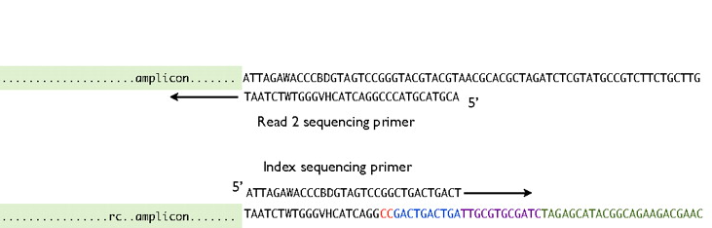
iTag Library Prep: Primer design
”Pad”
Stretch of random bases designed into PCR primers that is NOT designed to match any actual genomic sequence
Bases provide space (length) on which sequencing primers sit
Pad may provide additional chemistry advantages (think dimerization and melting temperatures) for the PCR primer
Notes:
Add imagine for context to where these are. Grey and black parts, make multiple slides.

Slide 30
iTag Sequencing
Sequence diversity at every base position matters!
Notes:
Need to dbl check on the last terms

Slide 31
iTag Sequencing
Sequence diversity can be added into primer design
Sequence multiple loci at once
”N stagger”
“N shuffle”
…TGAGACTTNGTGCCAGCMGCC…
…TGAGACTTNNGTGCCAGCMGCC…
…TGAGACTTNNNGTGCCAGCMGCC…
…TGAGACTTNNNNGTGCCAGCMGCC…
…TGAGACTTNNNNNGTGCCAGCMGCC…
…TGAGACTTNNNNNGTGCCAGCMGCC…
…TGAGACTTNNNNNGTGCCAGCMGCC…
…TGAGACTTNNNNNGTGCCAGCMGCC…
…TGAGACTTNNNNNGTGCCAGCMGCC…
Notes:
Switch out with Ns. Gray and black?

Slide 32
iTag Library Prep/Sequencing at Berkeley
16S – V3/V4 hypervariable regions
Fwd 515Fb, Rev 806Rb
ITS – Smith/Peay ITS1
Fwd Smith/Peay ITS1f, Rev Smith/Peay ITS2
~ 50% of reads are “flipped” in orientation
Currently running single-locus amplicon pools with 20M-25M read return, 0% PhiX
Notes:
Need to dbl check on the last terms

Slide 33
Common iTag sequencing questions
Which sequencer should I use?
How many bases should I run?
Should I do paired end reads?
How many reads do I need?
What are the proper controls for my study?
When in doubt, try a literature search
Notes:
Need to dbl check on the last terms

Slide 34
Common iTag sequencing questions
Which sequencer should I use?
How many bases should I run?
Should I do paired end reads?
How many reads do I need?
What are the proper controls for my study?
When in doubt, try a literature search
Notes:
Need to dbl check on the last terms

Slide 35
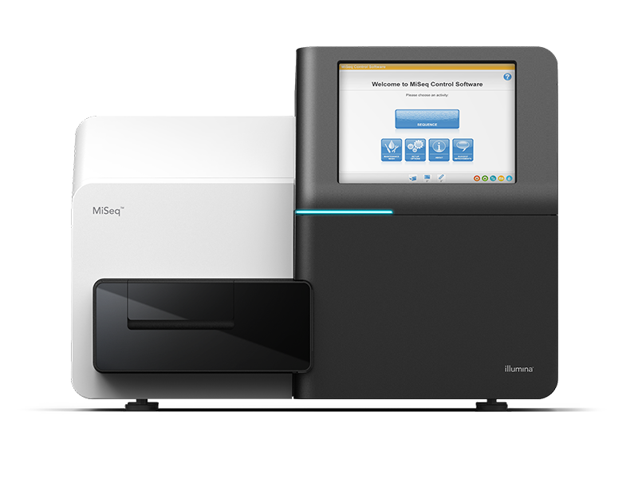
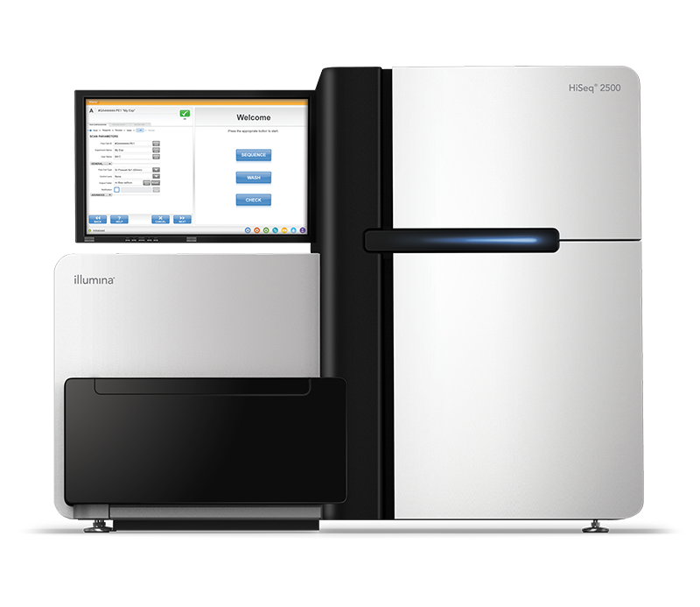
Basic Illumina Stats
HiSeq 2500 Rapid
MiSeq
15-25 million reads (v3 chemistry
300PE run ~4 days
Single lane
100-150 million reads per lane*
Run type (# of cycles) more flexible, faster
*Usually must run two lanes
Notes:
Put asterisk info at bottom of slide in small letters if you what to keep it,

Slide 36
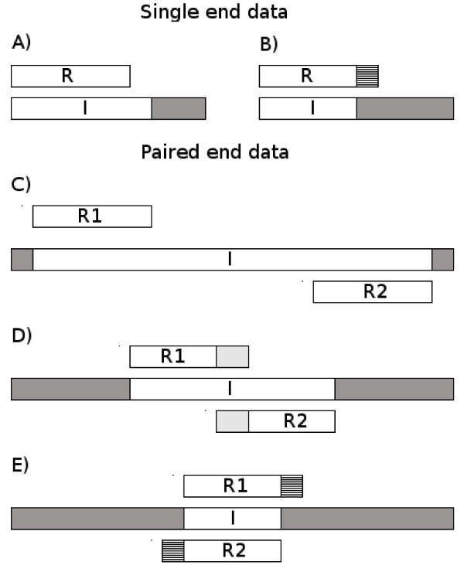
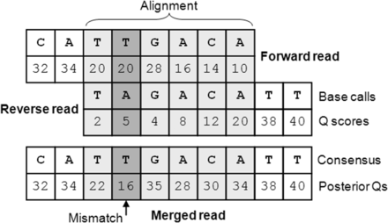
Benefits of paired end reads
Lindgreen 2012, BMC research notes
Edgar & Flyvbjerg 2015, Bioinformatics
Notes:
Need to dbl check on the last terms

Slide 37
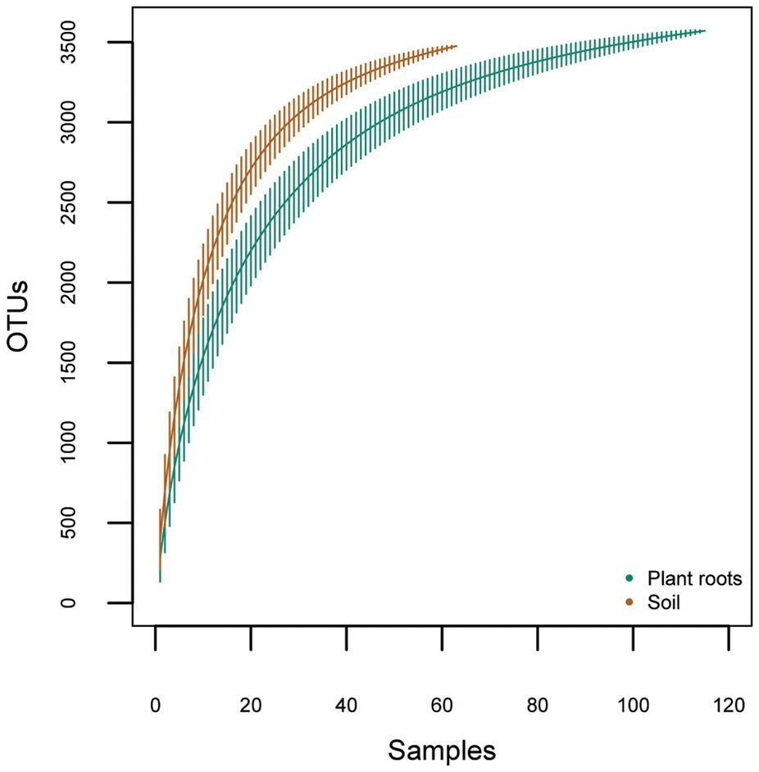
How many reads do I need?
Vic et al. 2013, Scientific Reports
Notes:
Need to dbl check on the last terms

Slide 38
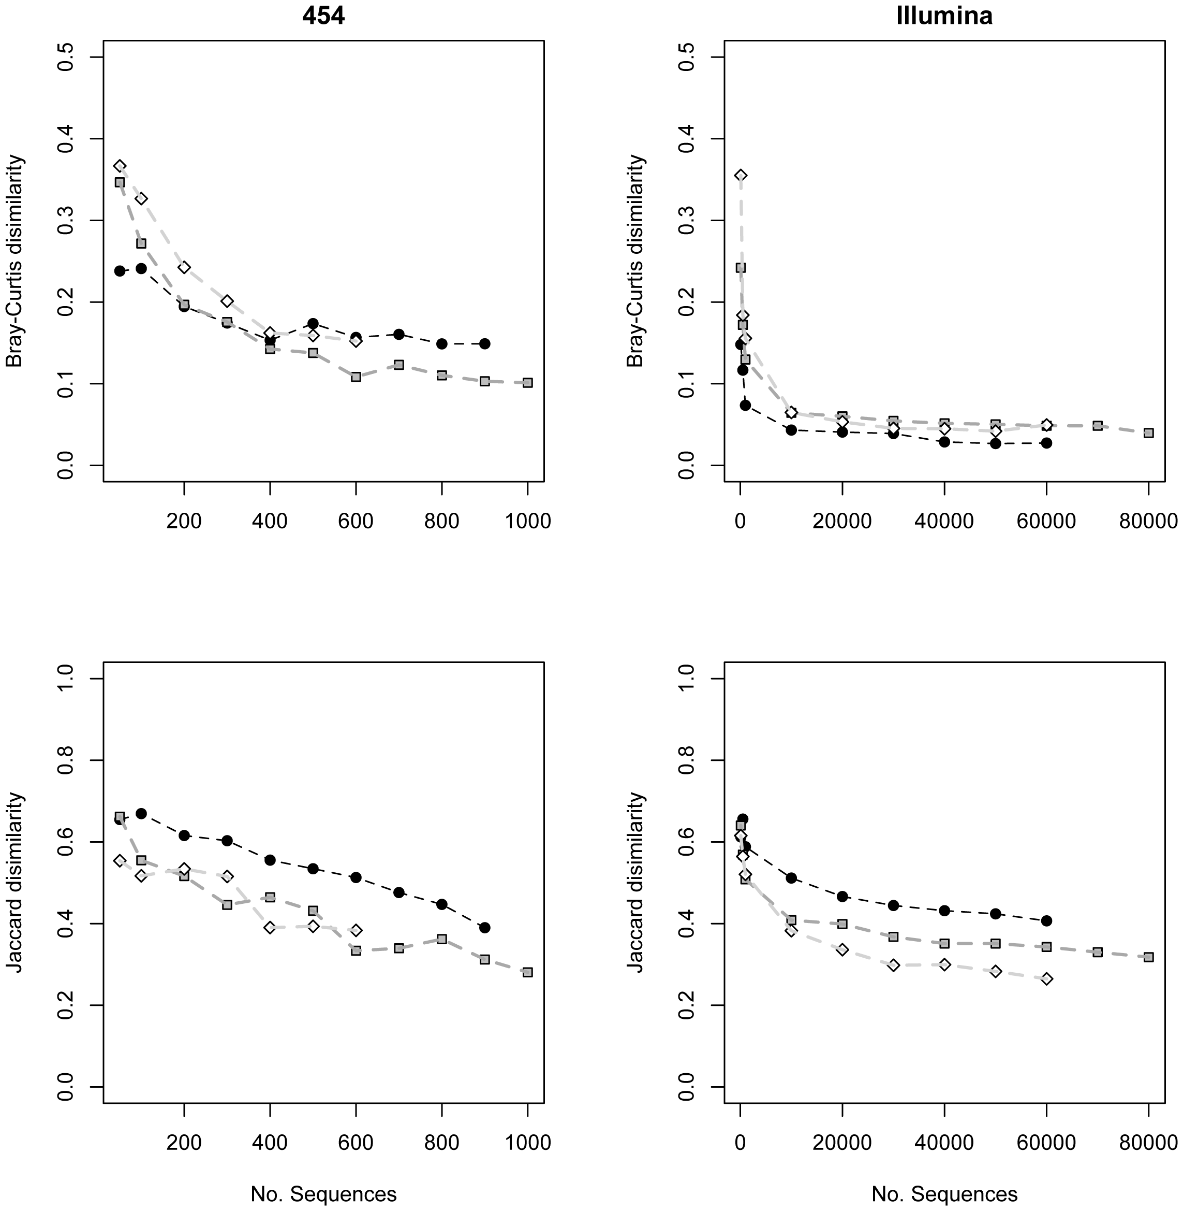
How many reads do I need?
Smith & Peay 2014, PLoS ONE
Notes:
Need to dbl check on the last terms

Slide 39
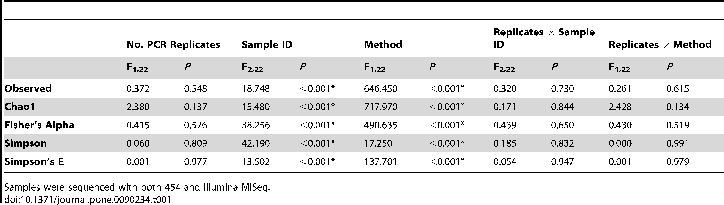
Controls – PCR replication
PCR replication – a common practice not rooted in scientific benefit!
Smith & Peay 2014, PLoS ONE
Notes:
Need to dbl check on the last terms

Slide 40
Controls – PCR replication
Smith & Peay 2014, PLoS ONE
Notes:
Need to dbl check on the last terms

Slide 41
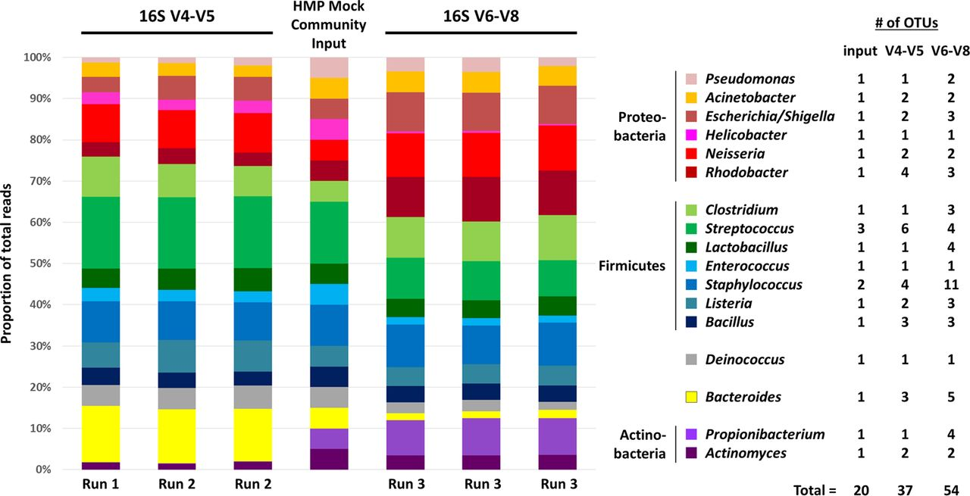
Controls – mock community
Comaeu et al. 2017, mSystems
Notes:
Need to dbl check on the last terms

Slide 42
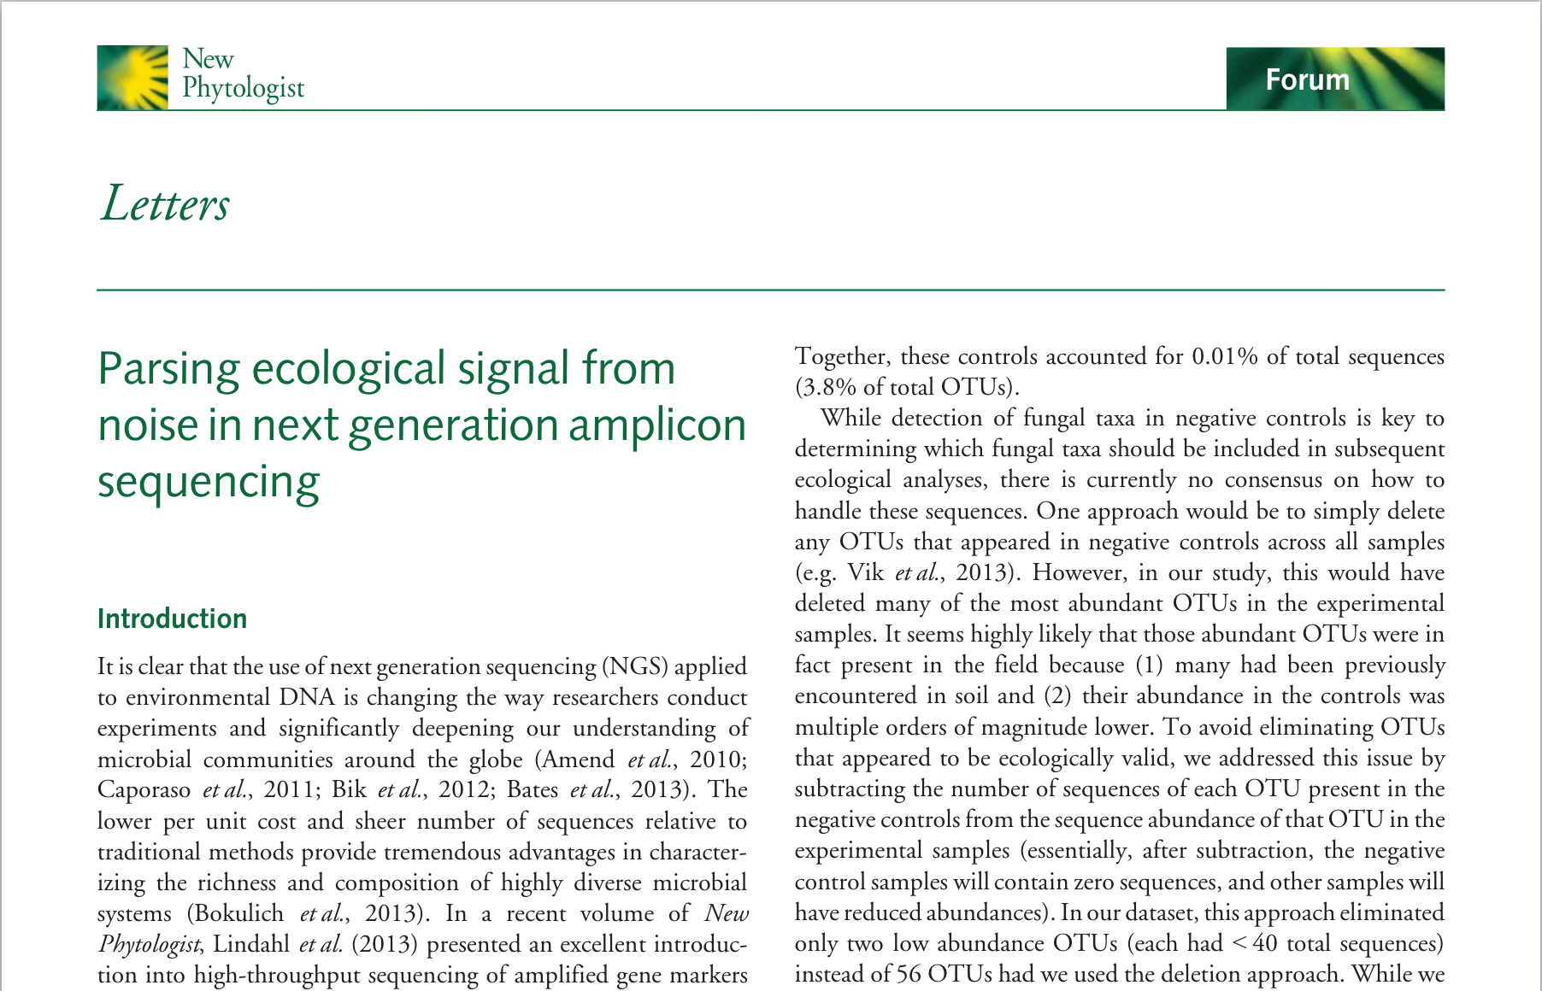
Controls & other concerns
Negative controls
OTU clustering methods
Low abundance OTUs
Singletons
Nguyen et al. 2015, New Phytologist
Notes:
Need to dbl check on the last terms

Slide 43
Controls & other concerns
Negative controls
OTU clustering methods
Low abundance OTUs
Singletons
Nguyen et al. 2015, New Phytologist
Notes:
Need to dbl check on the last terms

Slide 44
OTUs vs ASVs
OTUs (Operational Taxonomic Units)
Several to many sequences ”collapsed” into one reference sequence based on a discrete sequence similarity threshold
Functionally equivalent to ”species”
Several ways to delineate and pick OTUs
ASV (Amplicon Sequence Variants)
Each sequence treated as a piece of data with a taxonomy assignment
No sequence collapsing
More
Callahan et al. 2017, ISME
Notes:
Need to dbl check on the last terms

Slide 45
iTag with PacBio
PacBio – Single molecule real time sequencing
Pros:
Potential for much longer read length
Better phylogenetic potential
Better taxonomic assignments to reads
Cons:
Significantly higher error rate*
Significantly lower throughput
Notes:
Need to dbl check on the last terms

Slide 46
Genomics Core Seminar Series
THANK YOU!!!!

